Slide 1
Hadoop, IoT and Analytics - The Three Musketeers

Slide 2
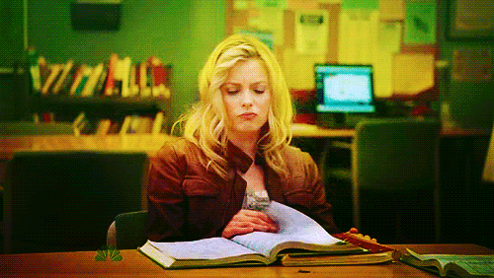
Before I go ahead Let me know Why I should waste my one hour in this webinar.
What is the Future in Hadoop,IoT and Analytics

Slide 3
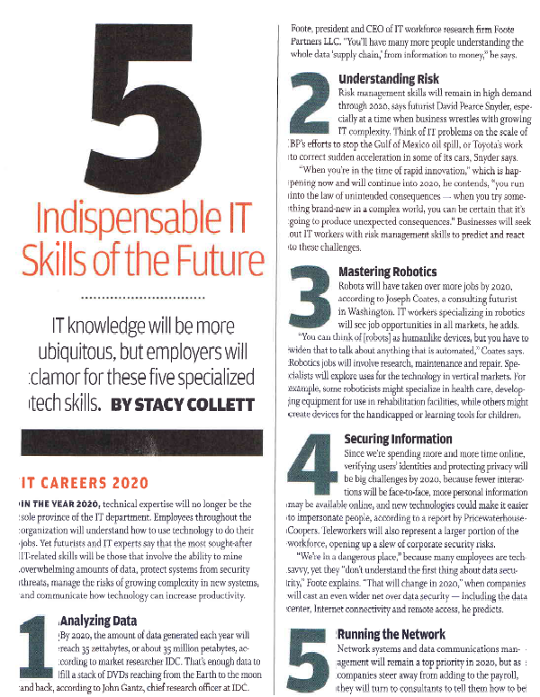
Why you should waste your one hour in this webinar
In the year 2020, technical expertise will no longer be the sole province of the IT department.
IT experts say that the most sought-after IT-related skills will be those that involve the ability to mine overwhelming amounts of data
Notes:
Analyzing large amounts of data is the top predicted skill required!

Slide 4

Agenda
At the end of the session, you will be able to know :
What is Hadoop
What is IoT
What is Analytics
How Hadoop , IoT and Analytics can be used together
Use Cases

Slide 5

First Thing First
What is Hadoop ?

Slide 6
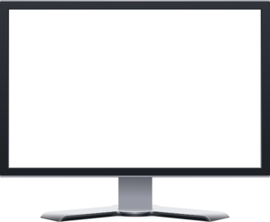
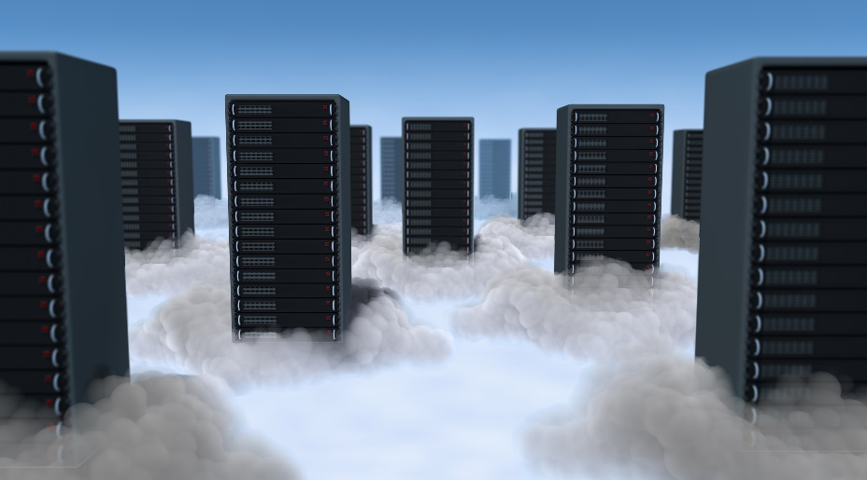
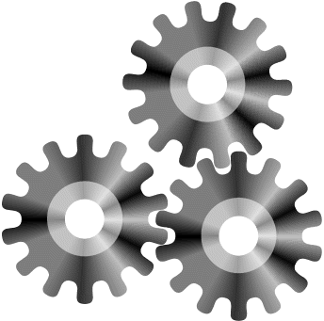
What is Hadoop
Hadoop is framework that powers a platform that stores and processes
“Big Data”
that is scalable and reliable and highly available
Multiple servers are connected via Hadoop as if it were one large computer

Slide 7
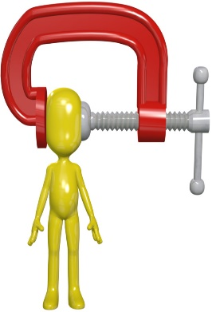
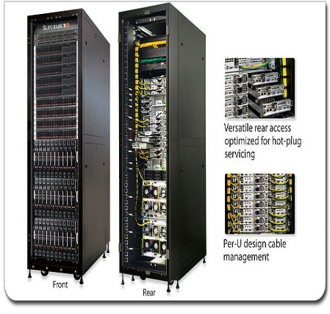
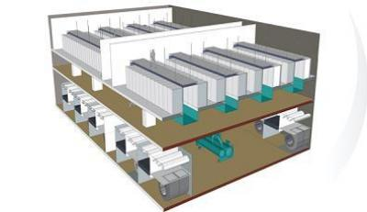
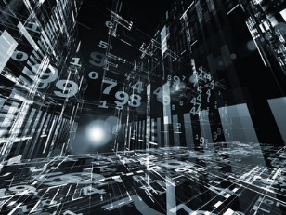
Different Layers
Hadoop has 3 layers :
Cluster Maintenance
Storage
Processing

Slide 8
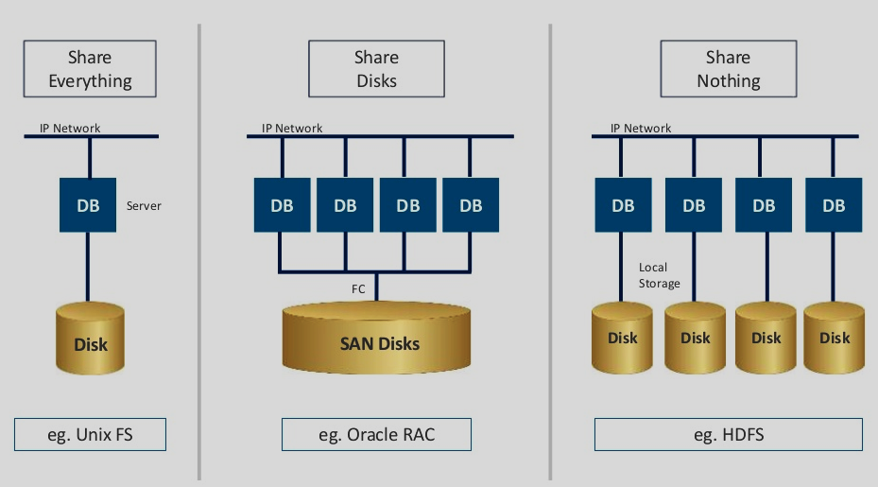
Hadoop Vs Other N/W Storage Architecture
Hadoop differs from other distributed storage in the way that it is a network of several independent storage serves

Slide 9
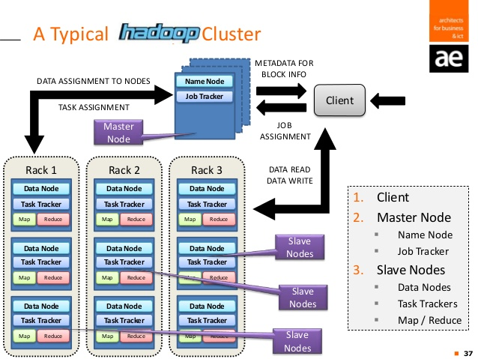
A typical Hadoop Cluster

Slide 10
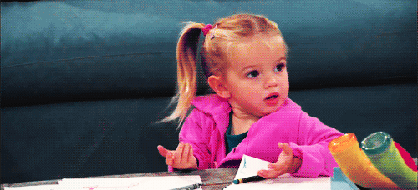
I am a bit confused with the term “Big Data”.
What is it??

Slide 11
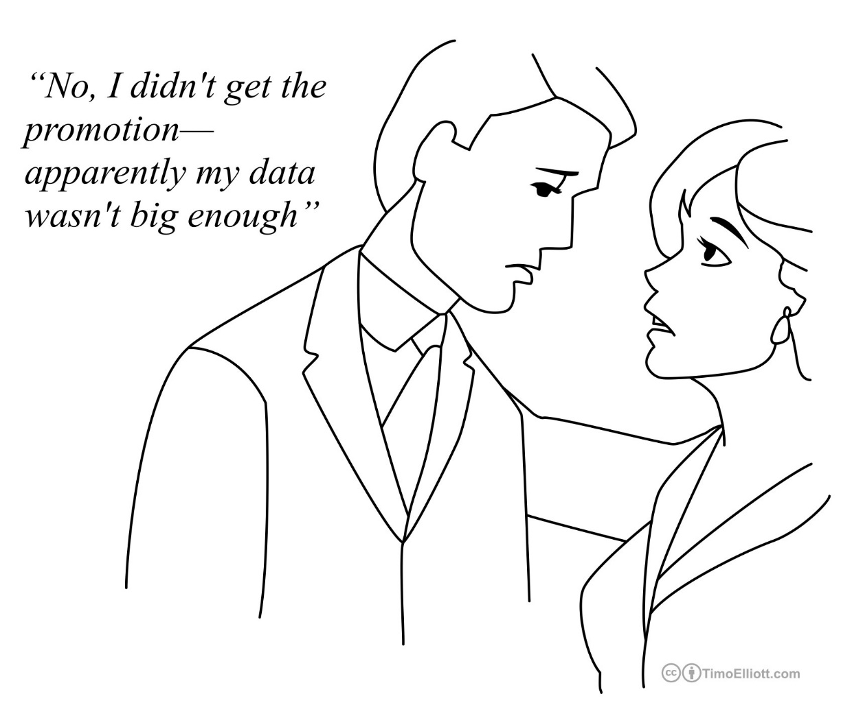
Big Data : A Hoax or Truth ??

Slide 12
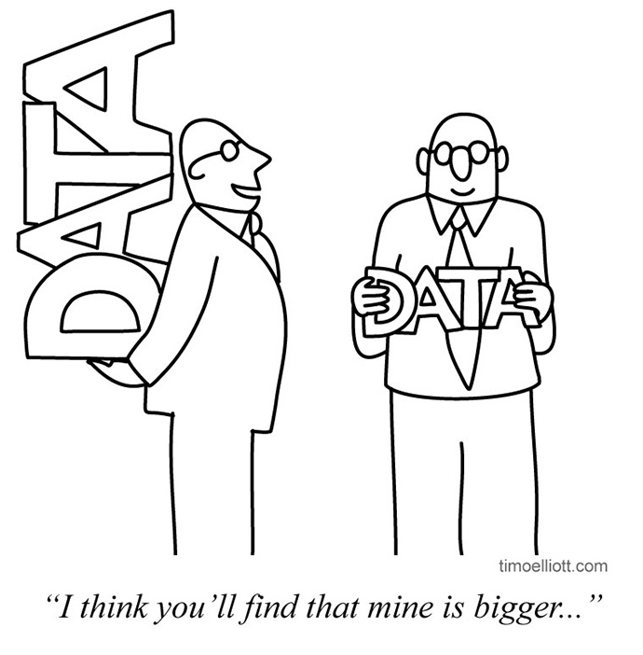
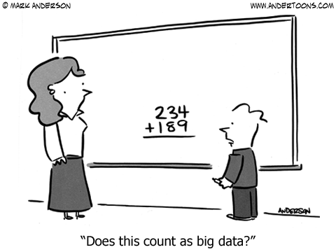
Big Data : A Hoax or Truth ??

Slide 13
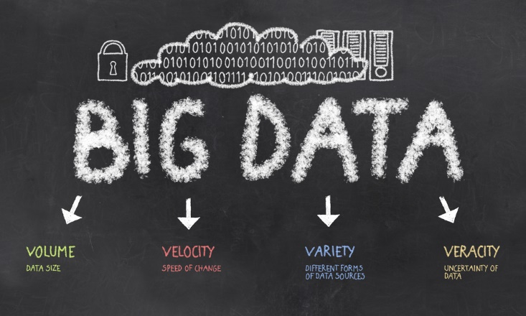

Slide 14
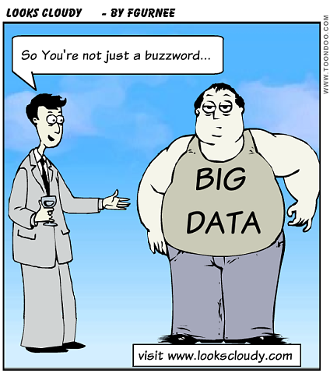
Big Data
Now I got it what is Big Data :
Big data is huge amount of data which is getting harder to be stored in traditional Databases.
It is a combination of :
Structured : Text, Excel files etc …
Unstructured : Videos, Audios etc …
Semi-Structured : Emails,Xml etc …

Slide 15

Big Data
It is:
Unstructured
Unprocessed
Un-aggregated
Un-filtered
Repetitive
Low quality
And generally messy.
Oh, and there is a lot of it.
Notes:
Big data is not called big data because it fits well into a thumb-drive.
It requires a lot of storage, partially because it’s a lot of data. Partially because it is unstructured, unprocessed, un-aggregated, repetitive and generally messy

Slide 16
Opinions about Big Data
"Data are becoming the new raw material of business"
Chris Lynch
former President and CEO Vertica Systems
“Torture the data, and it will confess to anything”
Ronald Coase
Economics, Nobel Prize Laureate
"The world is one big data problem"
-Andrew McAfee
Associate director of the Center for Digital Business
MIT Sloan School of Management
"Information is the oil of the 21st century, and analytics is the combustion engine"
- Peter Sondergaard,
Senior Vice President,
Gartner Research.
“In God we trust. All others must bring data.”
-W. Edwards Deming
statistician, professor, author, lecturer, and consultant

Slide 17
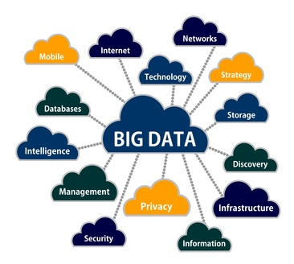
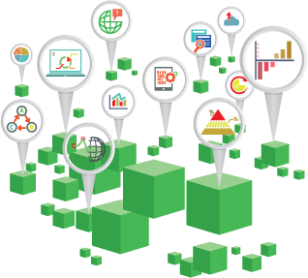
Where does this Big Data comes from
One of the major sources of all types of data is Internet

Slide 18
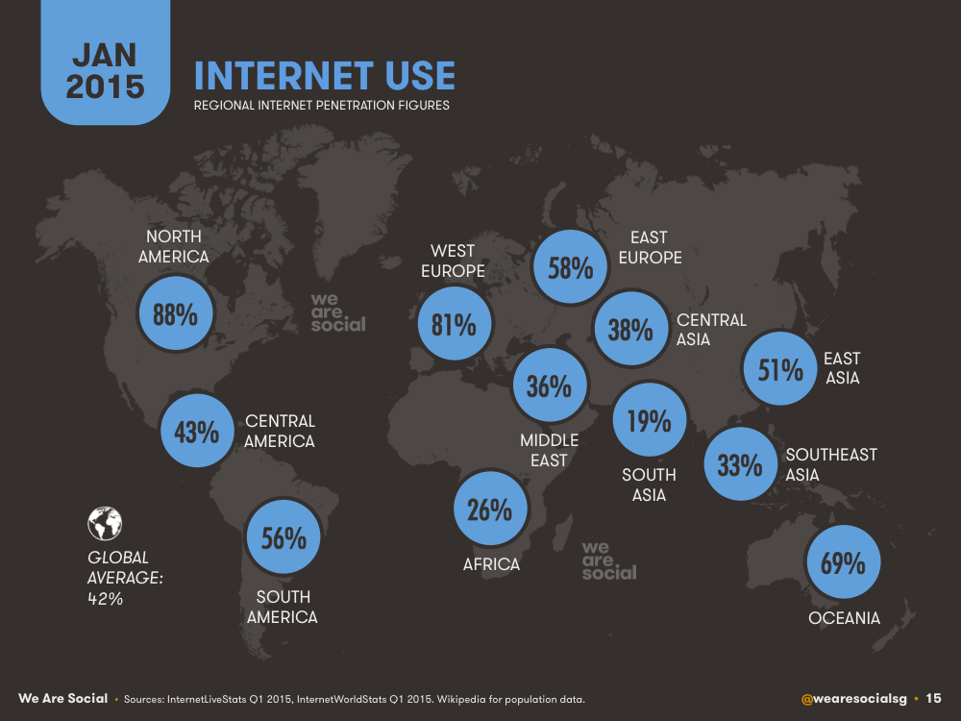
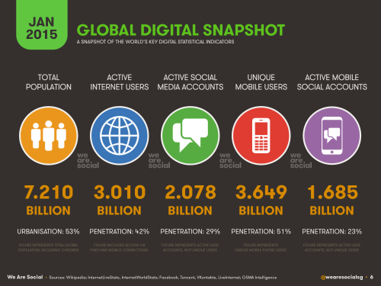
Data is growing with Internet
Almost 42% of the world’s population has access to the internet in January 2015

Slide 19
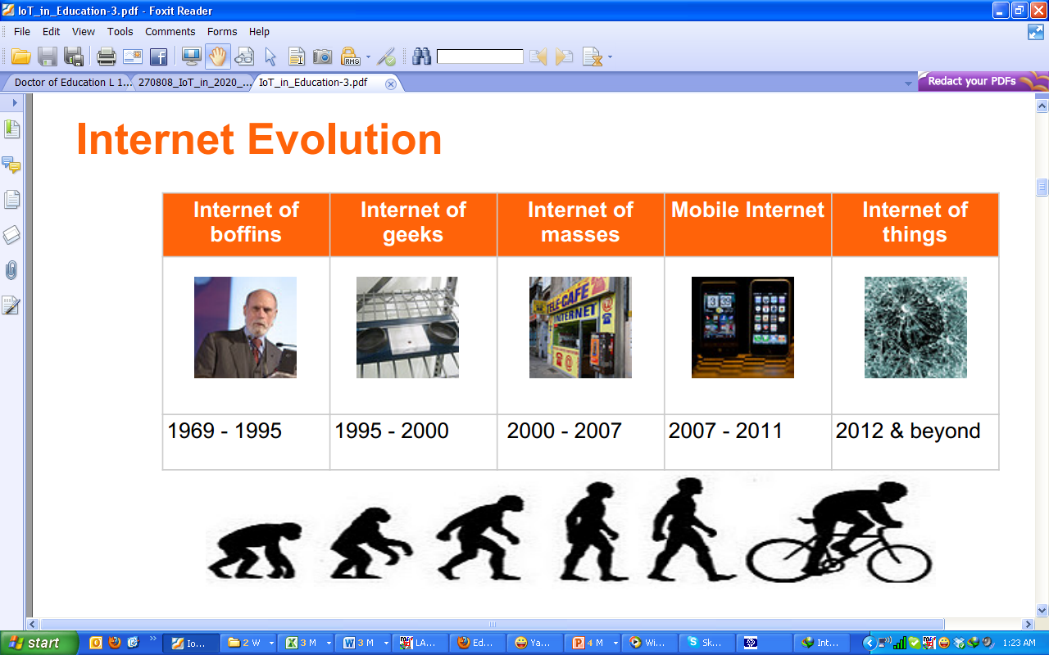
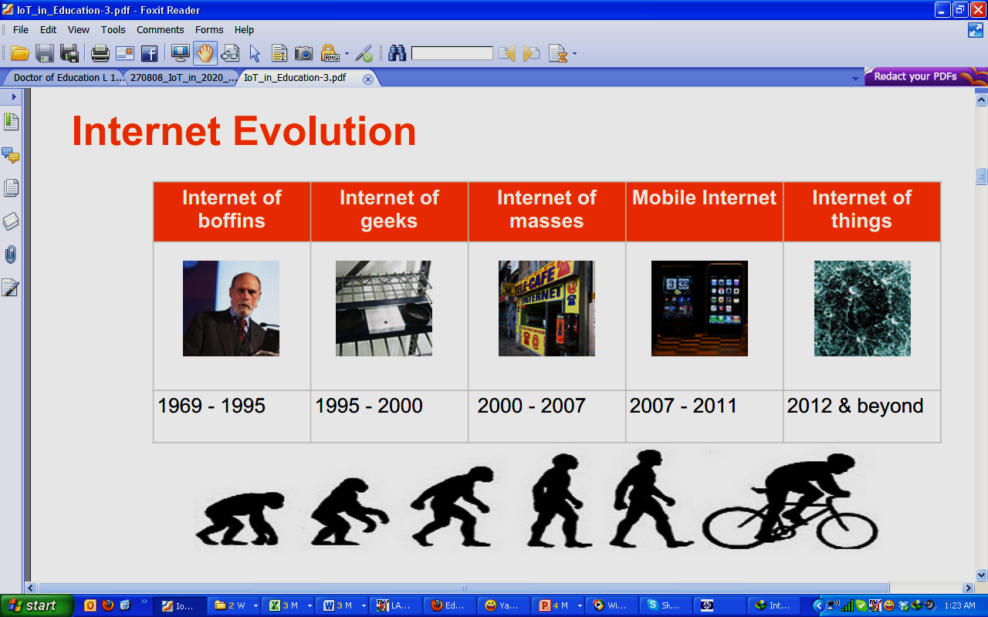
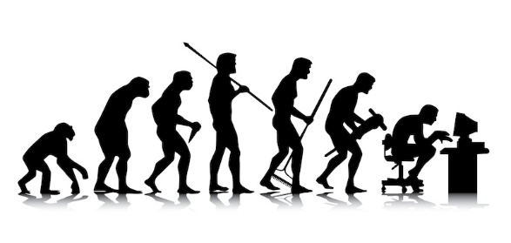
Data Explosion with Internet Revolution

Slide 20
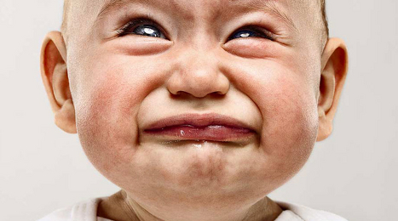
No !!!
I just understood “Big Data”
Now what is this
“Internet of Things”

Slide 21
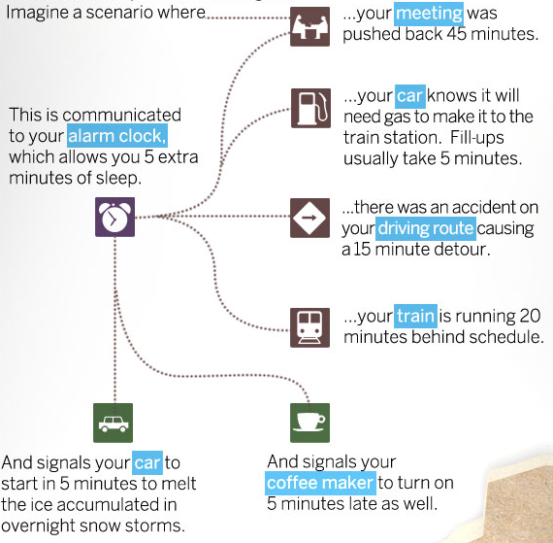
Just Imagine !!!
Machine need no manual instructions and become intelligent needing no manual intervention .

Slide 22

That sounds Cool !!!
But
Is it a reality ??

Slide 23
Mind-Boggling IoT Statistics
During 2008, the number of things connected to the internet surpassed the number of people on earth.
(CISCO)
By 2017, the IoT market will surpass the PC, tablet, and phone market combined.
(businessinsider)
82% of companies will have IoT applications implemented into their business in some way by 2017.
(businessinsider)
A recent finding from IDC predicts that the worldwide IoT market will grow to $7.1 trillion by 2020, compared to $1.9 trillion in 2013.
Gartner says there will be 26 billion connected devices by 2020. Cisco says there will be 50 billion, Intel says it will be 200 billion, and the IDC says 212 billion. In any case, these are all really big numbers.
94% of businesses see an ROI from M2M communication.
(CSGI)
The smart home industry was the leading industry in the IoT market in 2014 with $79.4 billion in revenue, followed by smart cities at $59.2 billion and smart building/infrastructure at $25 billion. Those numbers are expected to increase substantially by 2020.
(Pinterest)

Slide 24
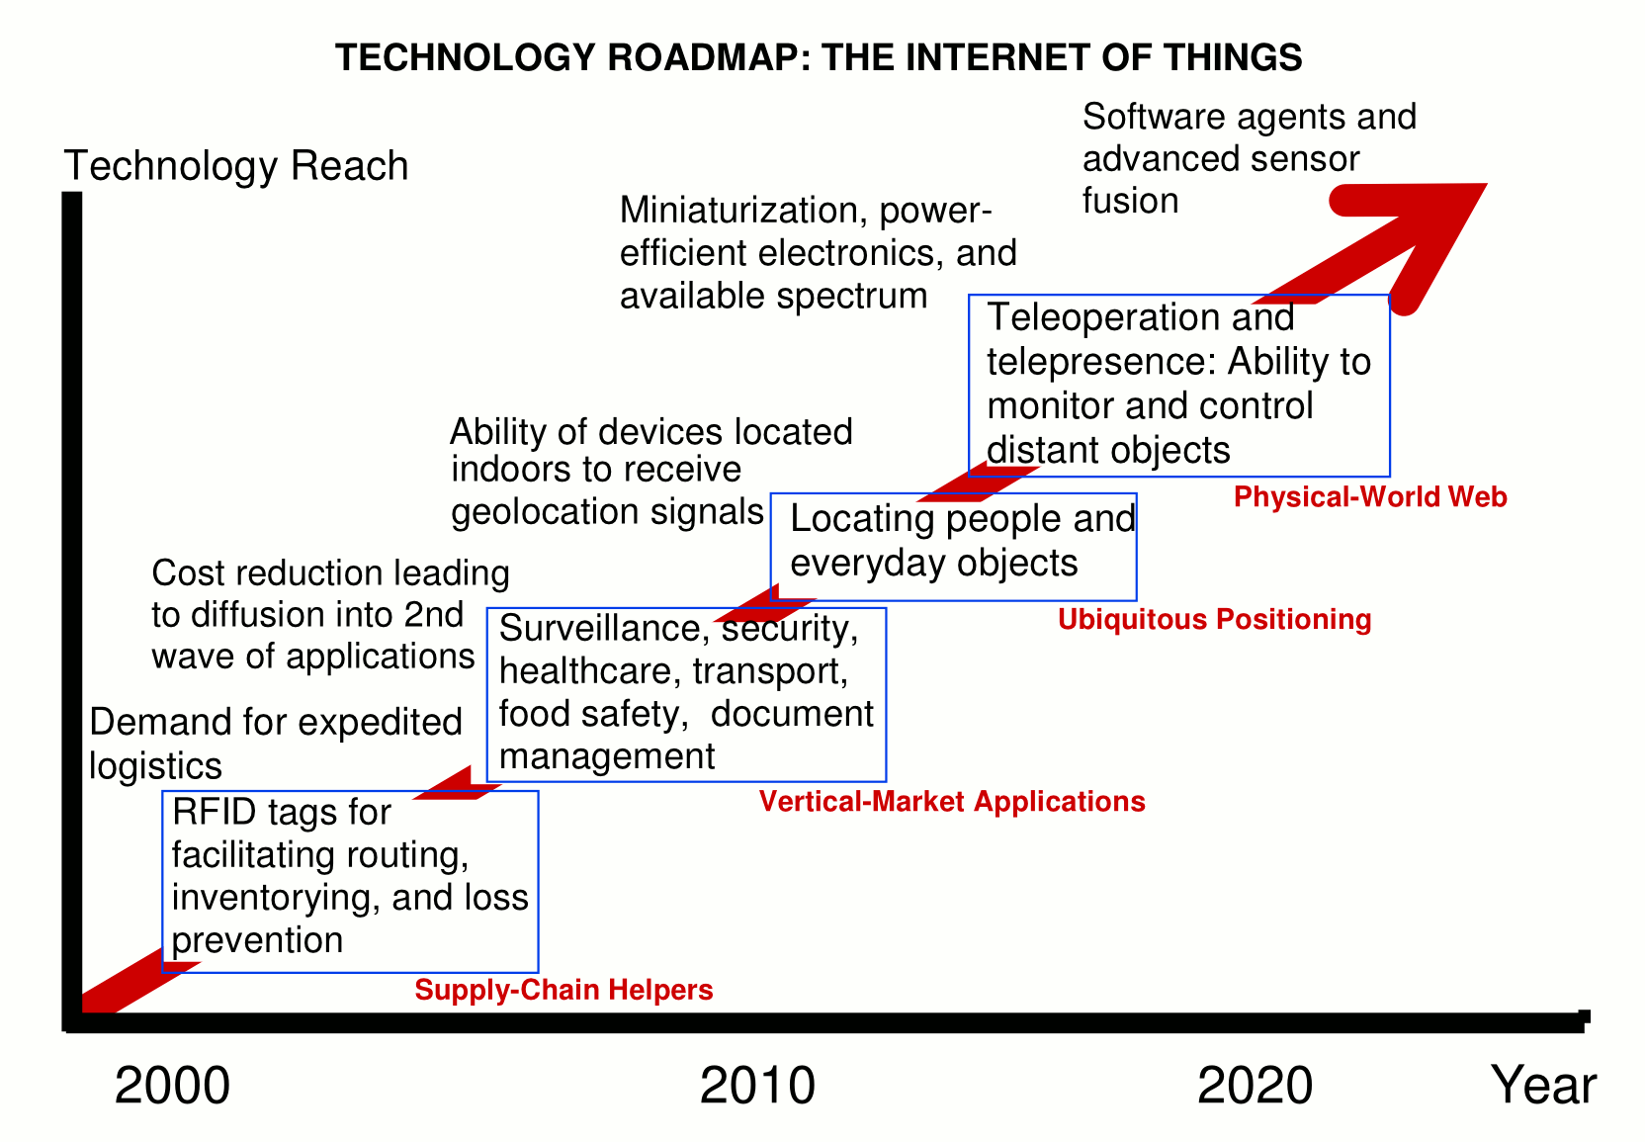
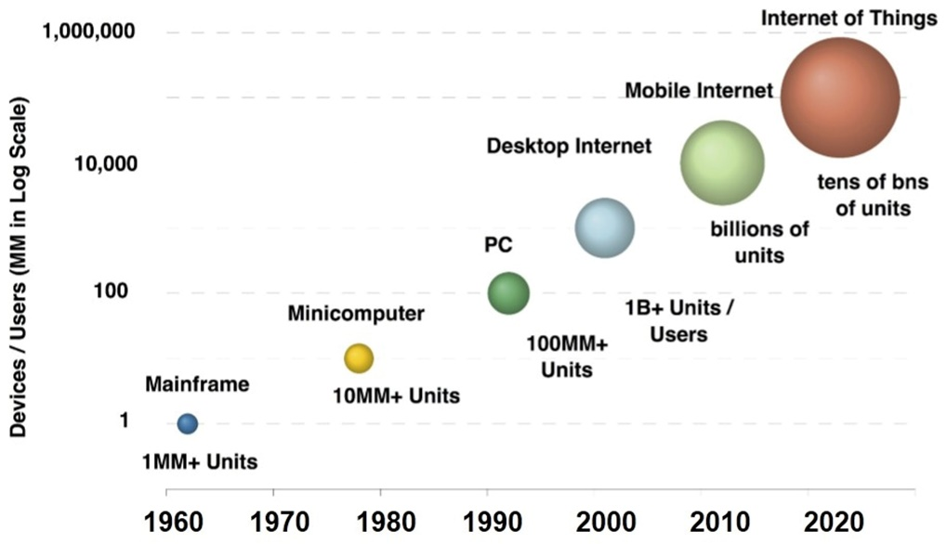
Technology Roadmap : IoT

Slide 25
Internet of Things (IoT)??
“Internet of Objects”
“Machine-to-Machine Era”
“Internet of Everything”
The Internet of Things, also called The Internet of Objects, refers to a wireless network between objects, usually the network will be wireless and self-configuring, such as household appliances.
------Wikipedia
Internet of Things refers to the concept that the Internet is no longer just a global network for people to communicate with one another using computers, but it is also a platform for devices to communicate electronically with the world around them.
------Center for Data and Innovation

Slide 26
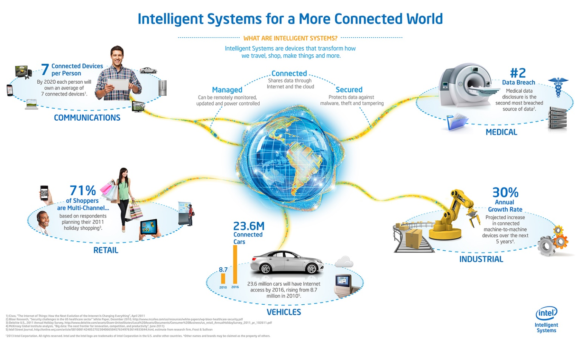
Internet of Things (IoT)??
An Era where Machines communicate with each other and are self configuring

Slide 27
Core Components
RFID
Sensor
Smart Tech
Nano Tech
To identify and track the data of things
To collect and process the data to detect the changes in the physical status of things
To enhance the power of the network by devolving processing capabilities to different part of the network.
To make the smaller and smaller things have the ability to connect and interact.

Slide 28
Application
Management
Education
Retail
IoT Applications
Food
Logistics
Pharmaceuticals

Slide 29


There is too much of the data we may get from IoT.
We know we can keep them all in Hadoop But What do we do with that ???

Slide 30
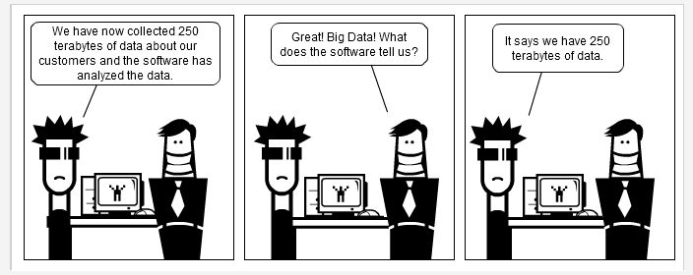
We Dig the data and Analyze
We can have a network of connected devices where the real time events and streams coming from the various devices are analyzed and as per the outcome other connected devices adapt accordingly

Slide 31
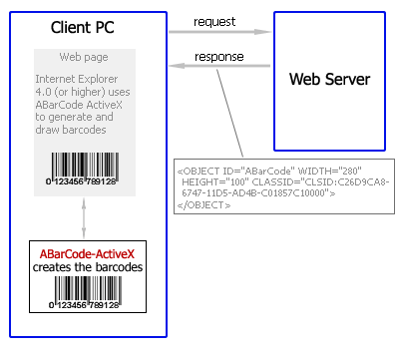
Application : Retail
Retail:
Intelligent shopping
Bar code in retail
Electronic tags
…

Slide 32
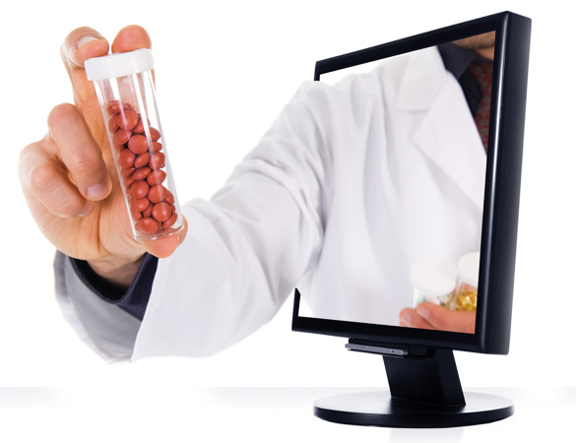
Application : Pharmaceuticals
Pharmaceuticals :
Intelligent tags for drugs
Drug usage tracking
Pharma. Product websites
--> Enable the emergency treatment to be given faster and more correct

Slide 33
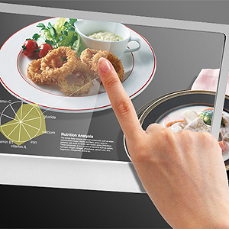
Application : Food chains
Food:
Control geographical origin
Food production management
Nutrition calculations
Prevent overproduction and shortage
Control food quality, health and safety.

Slide 34
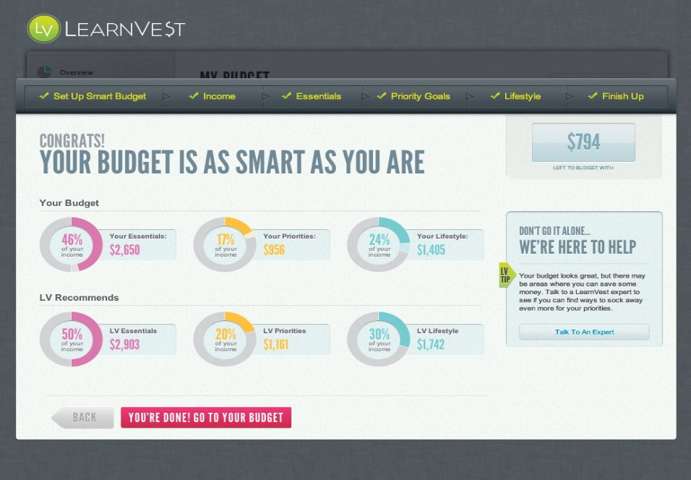
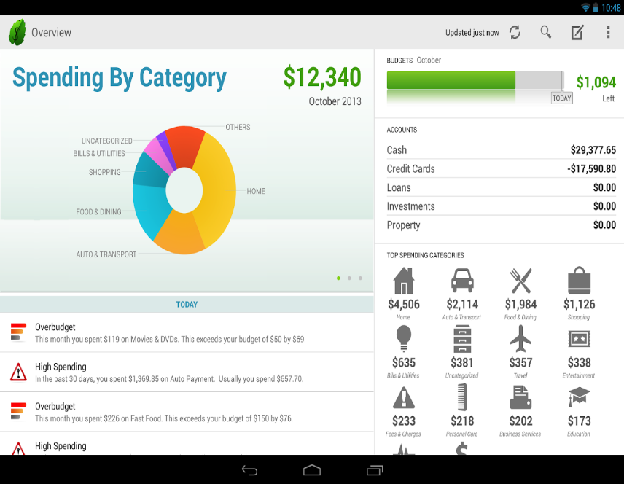
Application : Health
Sites like Mint.com and LearnVest allow consumers to review their spending by category and see where their money went in a given week, month or year.
User’s spending data is continuously monitored and analyzed to find a pattern which may help user in saving money and spending smartly

Slide 35
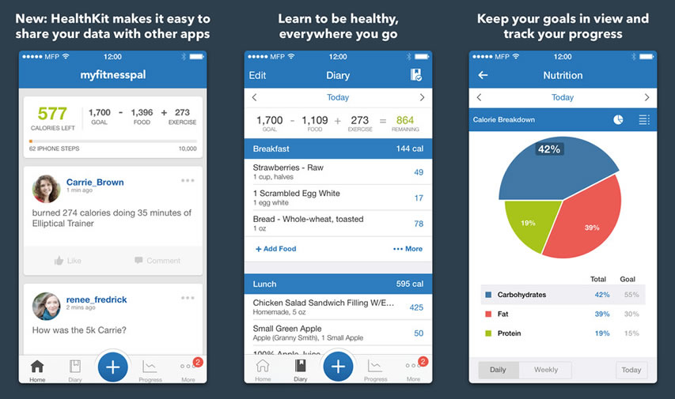
Application : Health
The food diary platform MyFitnessPal gives people not only detail of how many calories they’ve consumed each day but also breaks down protein, fat, and carbs.
These companies perform analytics on the huge data generated by the user’s mobile and they show the information extracted from customer’s raw data

Slide 36
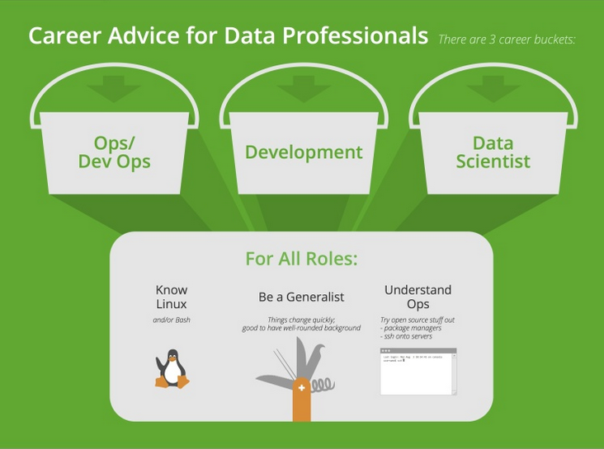
Career Mantra

